Slide 1
Initial Setup Lab-session 0
Computer Vision and Image Processing
Prof: Luigi di Stefano - luigi.distefano@unibo.it Tutor: Pierluigi Zama Ramirez - pierluigi.zama@unibo.it

Slide 2
Requirements
These slides will teach you how to configure and install the required libraries in your computer. Requirements:
Windows or Linux-Ubuntu (macOS and other Linux distributions are not tested but should work, follow Linux guidelines)
Internet connection
We will install:
Python 3.x
Pip
Python-Libraries: OpenCV, Matplotlib, Numpy
Jupyter Notebook

Slide 3
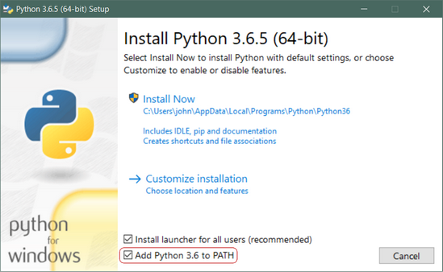
Step 1: Installing Python 3.x
Two main versions of Python: Python 2.x and Python 3.x are available.
The two version have several features in common, the two version are not fully compatible between each other and a Python 2.x program may not work for Python 3.x and vice versa.
Installing on Windows:
Download the latest Python3 release from: https://www.python.org/downloads/windows/
Run the installer. Remind to Add Python to PATH
Installing on Ubuntu:
Ubuntu already have Python installed already. If you want to update it to the latest version open your terminal and run:
sudo apt-get install –upgrade python3

Slide 4
Step 2: Installing pip
PIP is a recursive acronym that stands for “PIP Installs Packages”. It’s a command-line utility that allows you to install, reinstall, or uninstall Python packages with a simple and straightforward command: pip
Installing on Windows:
Download the get-pip.py installer from:

